Slide 1
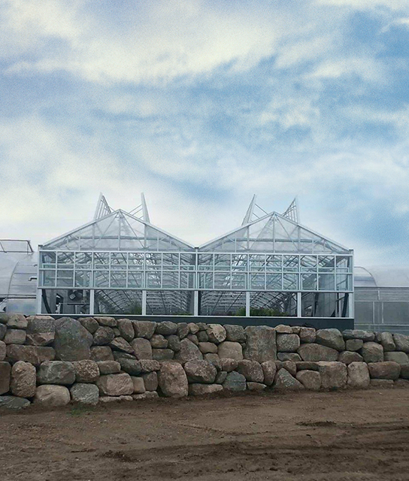

Cast 2025
Review & New Variety HIGHLIGHTS

Slide 2
VEGETABLEs
Seed options

Slide 3

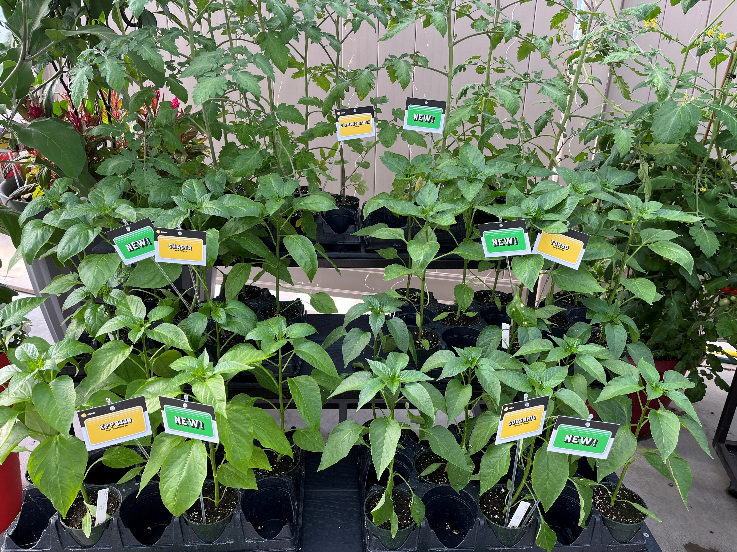
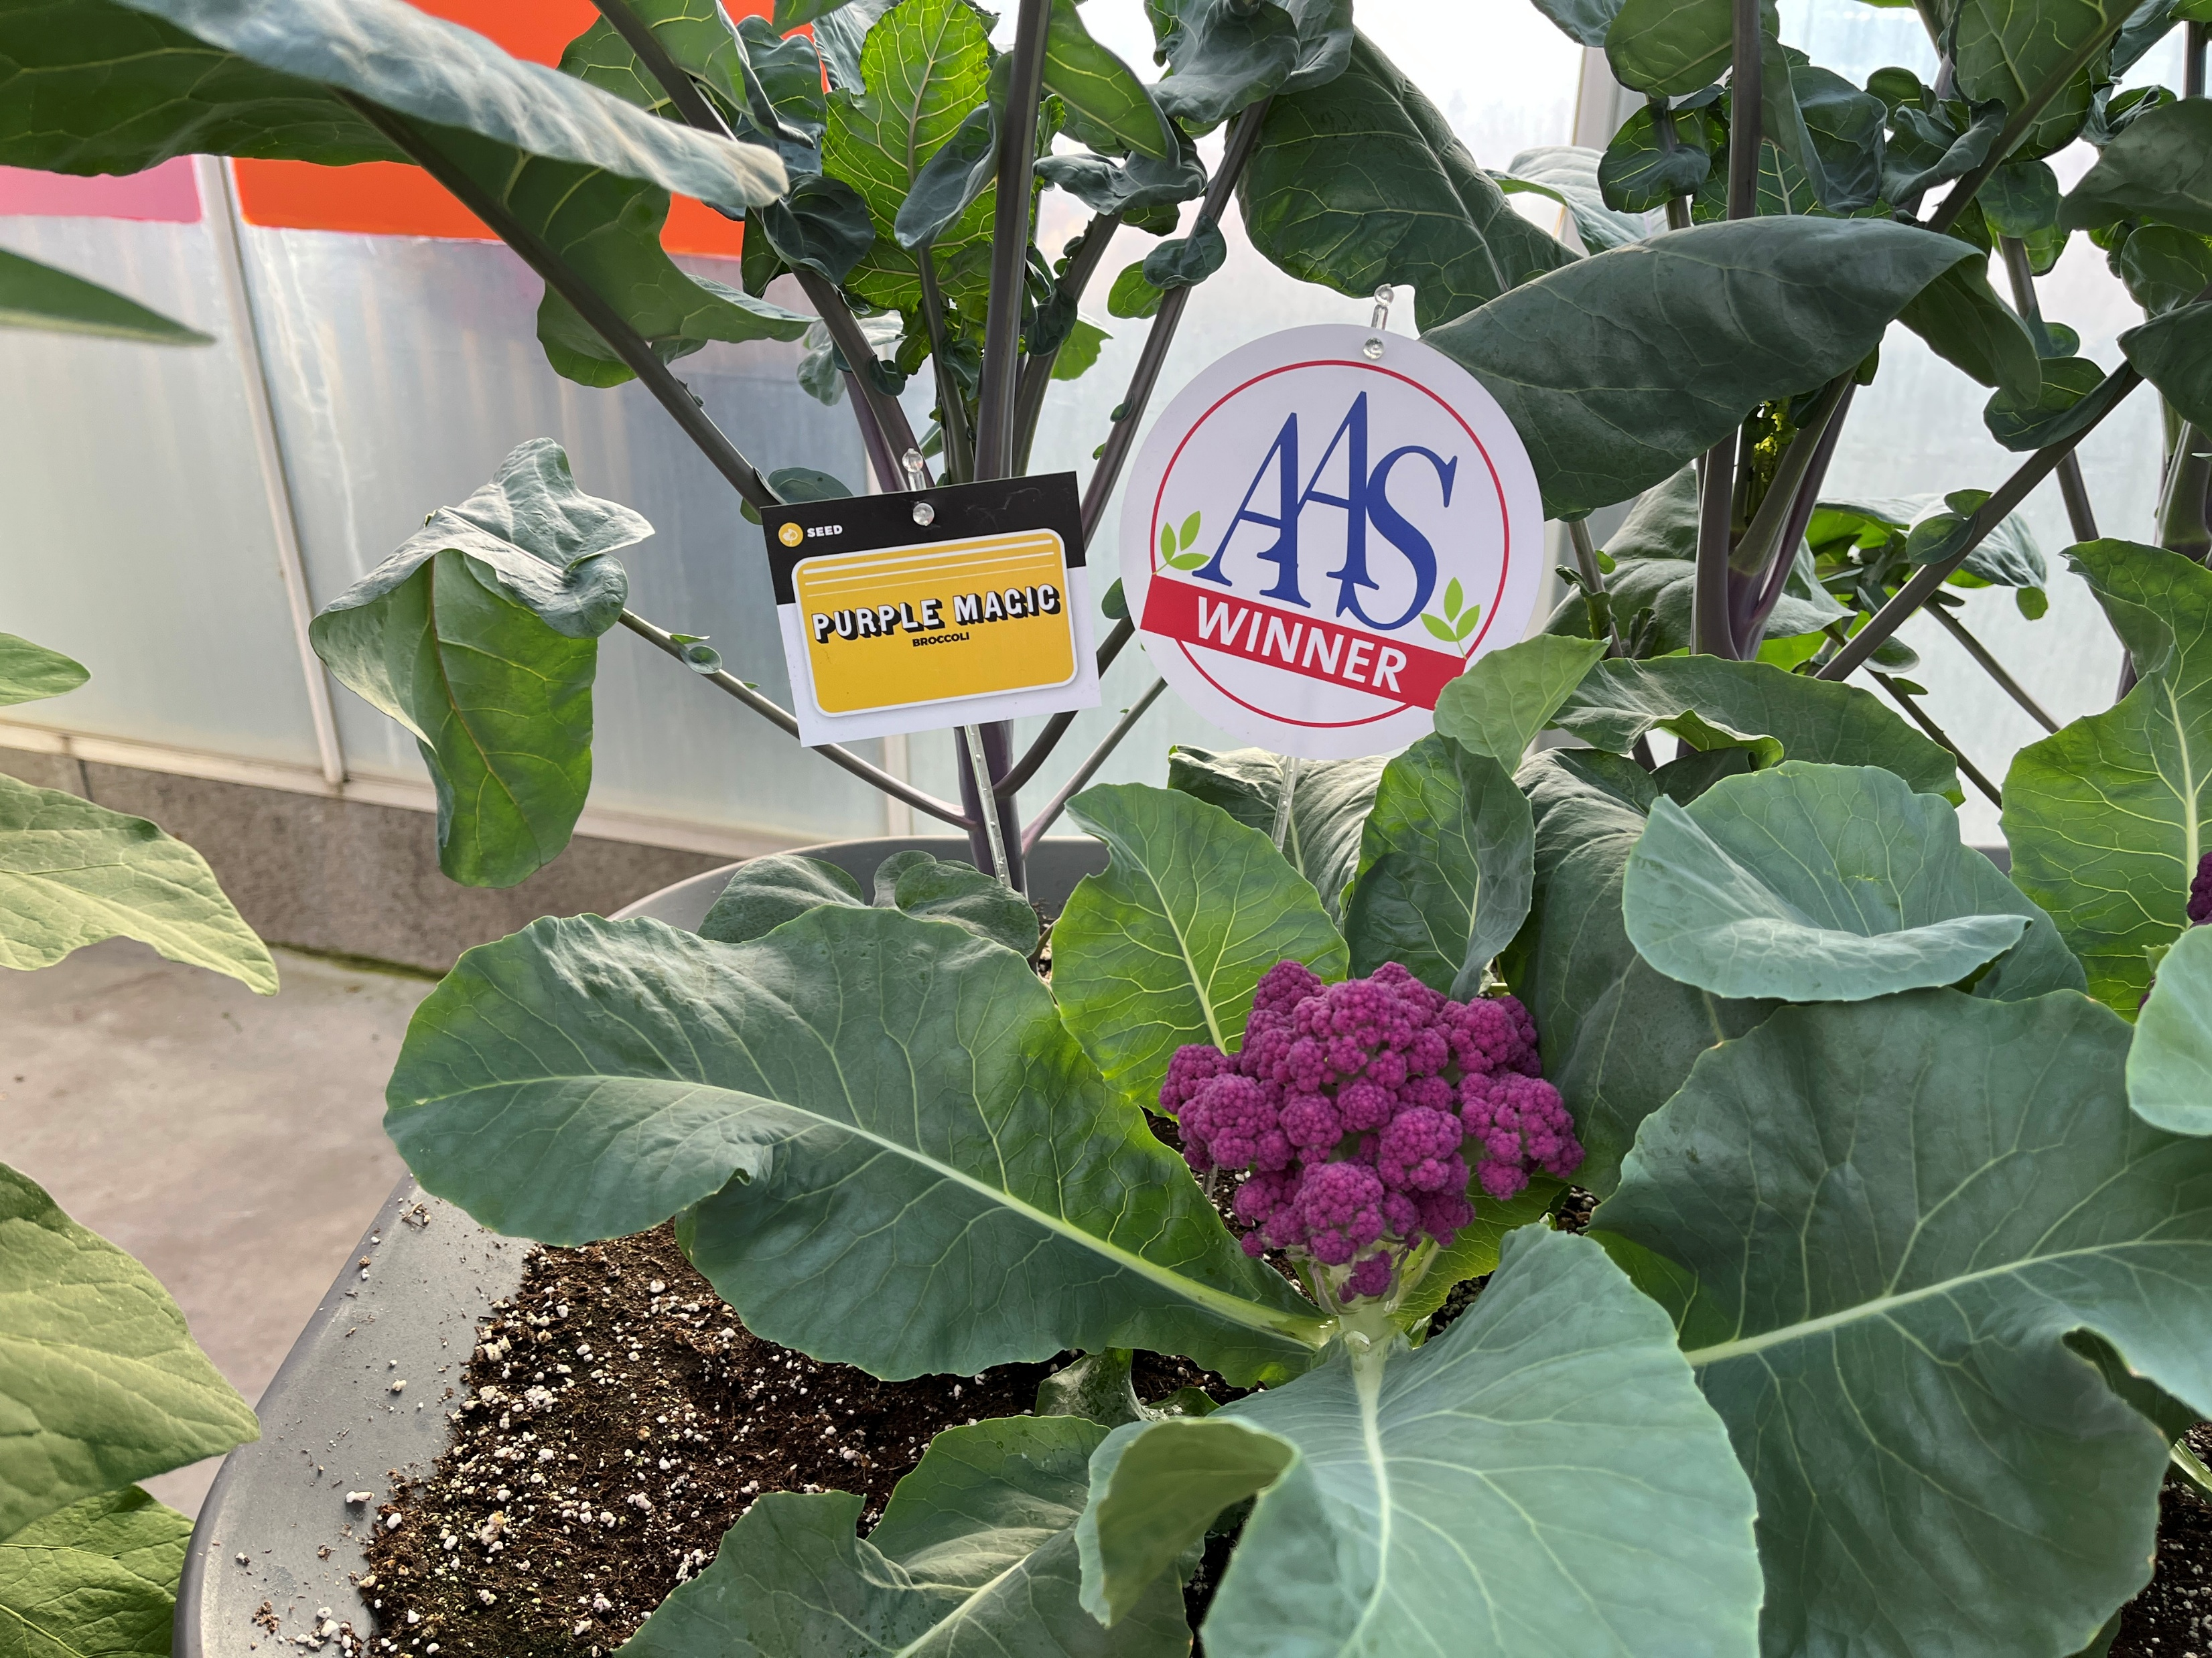
Home Grown Vegetables
  AAS winners – lots of options
    Squash Thriller
    Broccoli Purple Magic
  Peppers
    Goal is to breed in disease resistance to BLS and to prioritize Phytophthora resistance
    Offer varieties slotted for particular regions or well adapted across many climates
  New Lettuce Pint Sized
    5-6 inch, 1 -2 serving crisp heads on compact plants

Slide 4

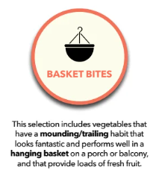
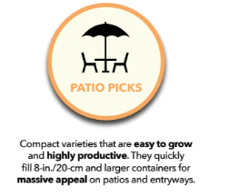
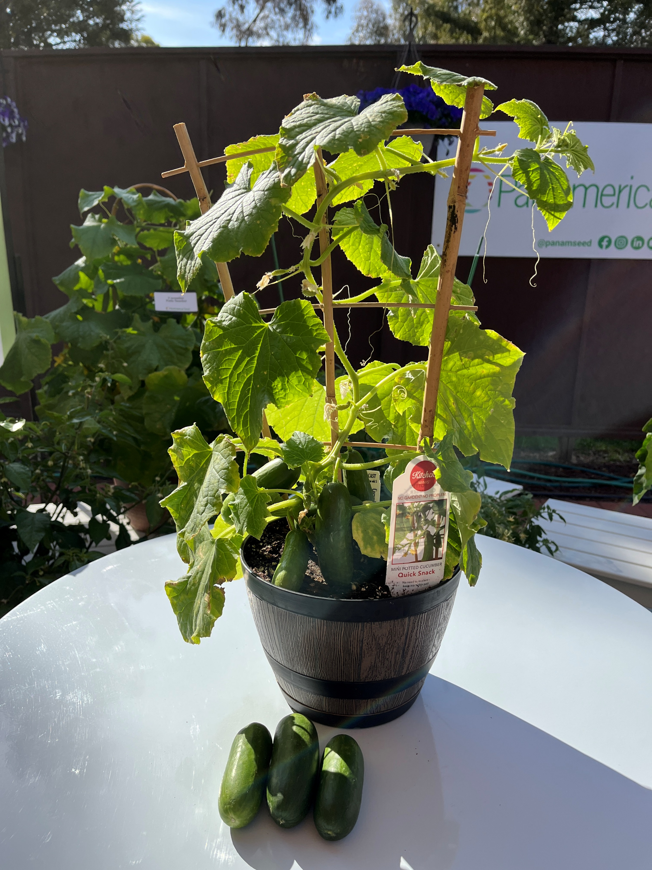


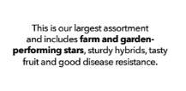
Kitchen Mini Cucumber Quick Snack

Slide 5

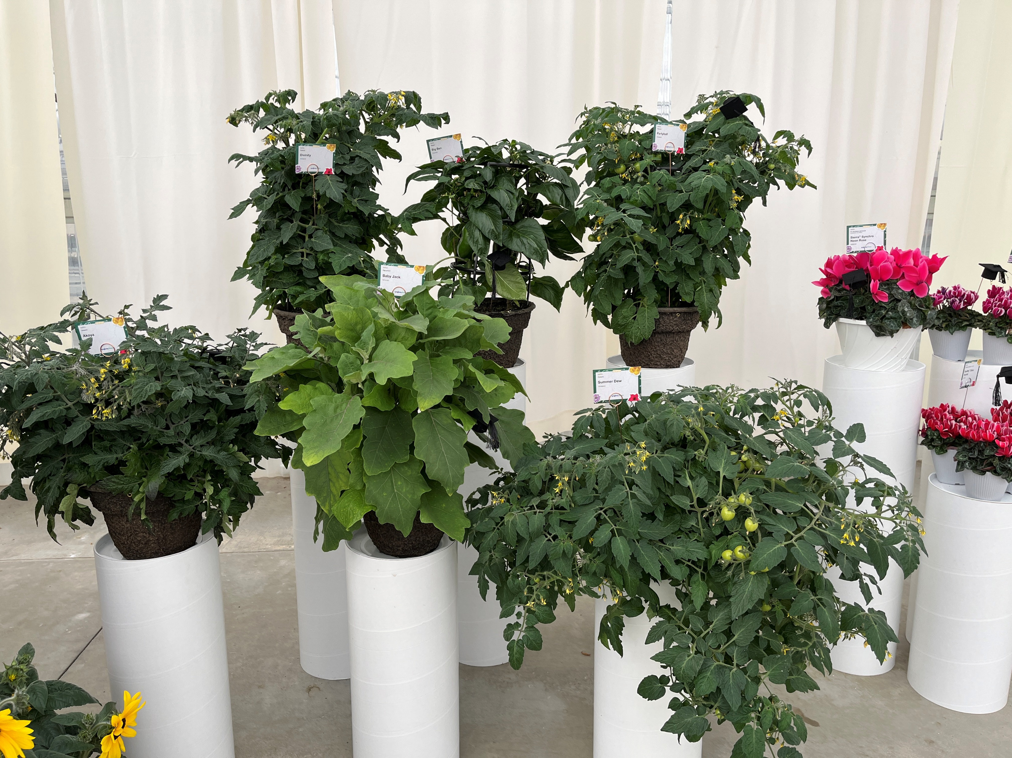

Syngenta Vegetalis – New Varieties
Emphasis on flavor and disease resistance, for containers and small spaces
Tomato Divinity
  Large slicer with Late Blight disease tolerance
Pepper Big Ben
  Dwarf habit, produces large blocky red fruits
  Excellent heat tolerance and some tolerance to Tobacco Mosaic virus
Tomato Partyball
  Sweet cherry sized fruits
  Resistant to Tomato Mosaic virus and tolerant to Late Blight
Tomato Akoya
  Cocktail tomato harvest when turns from black to orange.
  Late Blight tolerant
Eggplant Baby Jack
  Small purple round fruits, very compact variety for patio and container gardening
Tomato Summer Dew
  Semi-trailing cherry with pear shaped fruits.
  Resistant to Tomato Mosaic virus and tolerant to Late Blight

